Slide 1
REVIEW-2
Group No:341
Guided by : Dr. prashant kumar pandey

Slide 2
Submitted by-
1.21BCE10604 -AMIT KUMAR BHADRA
2.21BCE10711- ADARSH ANAND
3.21BCE10463- PRIYANSH SHRIVASTAVA
4.21BAI10360- KUMAR PRINCE
5.21BCG10102 -SOURABH U PILLAI
6.21BCE11613 -DHANANJAY VITTHAL THOKAL
7.21BCE11675- PRIYANKA KUMARI
8.21BCE10845 -RISHI R BHUVA
9.21BCE11264- SARTHAK SATYAVAN GADGE

Slide 3
INDEX
Introduction
Objective / Problem statement
Literature Review
Overall system architecture diagram and flow diagam
Module splitup and explanation
Module Implementation
References

Slide 4
INTRODUCTION
In the contemporary healthcare landscape, accessibility and transparency are paramount. Individuals seek personalized healthcare solutions tailored to their needs and preferences. Addressing these requirements, our project endeavors to develop a comprehensive platform facilitating the selection of hospitals based on user preferences. Furthermore, the platform integrates various features including doctor comparison, budget-based analysis, medicine recommendations, disease symptom prediction, and predictive analytics for diseases like cancer, heart diseases, diabetes, and mental health issues.
The healthcare sector is witnessing a digital transformation, with technology playing a crucial role in enhancing patient experiences and outcomes. Our project aligns with this trend by leveraging technology to provide users with a user-friendly and feature-rich platform for healthcare decision-making. By integrating multiple functionalities into a single platform, we aim to address the diverse needs of users while promoting transparency and accessibility in healthcare services.

Slide 5
OBJECTIVE
Hospital Selection: Enable users to easily find hospitals based on location, services offered, and patient reviews.
Doctor Comparison: Implement a feature allowing users to evaluate physicians based on credentials, specialties, and patient feedback.
Cost Analysis: Integrate budget-based analysis functionality enabling users to compare treatment costs across different hospitals.
Medicine Recommendation: Deploy a search engine for medication recommendations based on user symptoms and medical history.
Predictive Analytics: Develop predictive analytics models for disease symptom prediction, focusing on cancer, heart diseases, diabetes, and mental health issues.
E-commerce Platform: Establish an e-commerce store for patients to conveniently procure medications and healthcare products.
Telemedicine Integration: Incorporate features for virtual consultations, enabling remote access to healthcare services.
Health Tracking: Provide tools for users to track health metrics and receive personalized recommendations.

Slide 6
OBJECTIVE
Appointment Scheduling: Implement a system for users to book appointments online and receive reminders.
Community Support: Create a community space for users to connect, share experiences, and provide support.
Language and Accessibility: Ensure accessibility features and language translation options for diverse users.
Integration with Wearable Devices: Connect with wearable fitness trackers to integrate health data seamlessly.
Electronic Health Records (EHR) Integration: Enable integration with EHR systems for comprehensive patient data access.
Emergency Assistance: Provide features for users to access emergency services and share medical information.
Health Insurance Integration: Facilitate interaction with health insurance providers for coverage information and claims submission.

Slide 7
PROBLEM STATEMENT
Difficulty in finding suitable hospitals and physicians based on location, services offered, and patient feedback.
Lack of comprehensive cost analysis tools, making it challenging for patients to compare treatment costs across different healthcare providers.
Inefficiency in accessing medication recommendations tailored to individual symptoms and medical history.
Limited availability of predictive analytics models for early disease symptom prediction, particularly in areas like cancer, heart diseases, diabetes, and mental health issues.
Inconvenience in procuring medications and healthcare products, necessitating a more streamlined e-commerce solution.
Limited access to virtual healthcare services, preventing patients from accessing timely care remotely.
Challenges in health tracking, appointment scheduling, and accessing emergency assistance efficiently.
Lack of integration with wearable devices, electronic health records (EHR), and health insurance providers, hindering seamless access to comprehensive healthcare information and services.

Slide 8
Literature Review
1.Hospital and Doctor Selection:
User-friendly platforms incorporating patient feedback crucial for informed decision-making.
Smith et al. (2019) stress the impact of patient reviews on satisfaction and outcomes.
2.Predictive Analytics:
Machine learning aids in disease symptom prediction and patient risk assessment.
Johnson et al. (2020) showcase the efficacy of predictive models in early intervention.
3 . E -commerce in Healthcare:
Online pharmacies enhance medication access and adherence.
Chen et al. (2018) highlight the importance of secure and convenient platforms.

Slide 9
Cost Analysis:
Transparency in treatment costs aids patient decision-making.
Jones et al. (2021) advocate for budget-based analysis features in healthcare platforms.
Medicine Recommendation Systems:
AI-driven algorithms personalize medication suggestions based on symptoms and history.
Kim et al. (2019) demonstrate the effectiveness of recommendation engines in improving treatment outcomes.

Slide 10
Module splitup and explanation
User Interface Module: Allows users to input preferences and search for hospitals, doctors, and medications.
Hospital Search Module: Filters hospitals based on location, services offered, and patient reviews.
Doctor Comparison Module: Provides information on doctor credentials, specialties, and patient feedback.
Budget Analysis Module: Compares treatment costs across different hospitals.
Medicine Recommendation Module: Utilizes search engine for medicine recommendations based on symptoms and medical history.
Predictive Analytics Module: Implements machine learning algorithms for disease symptom prediction and patient risk assessment.
E-commerce Store Module: Facilitates procurement of medications and healthcare products.

Slide 11
Architecture diagram

Slide 12
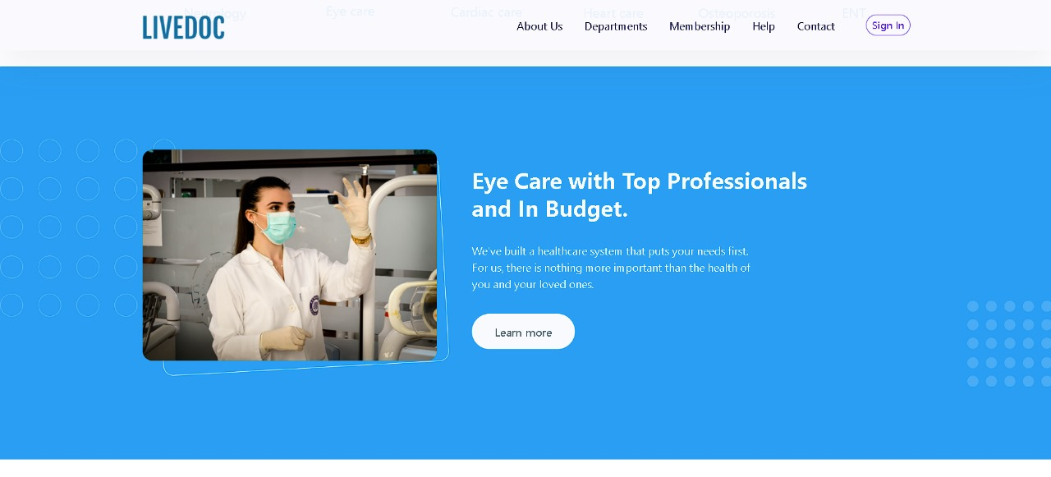
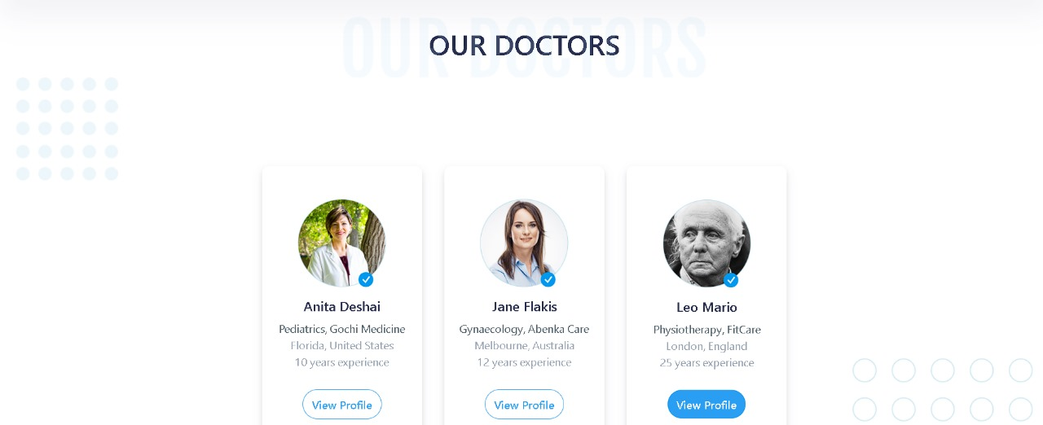

Slide 13
Flow diagram

Slide 14
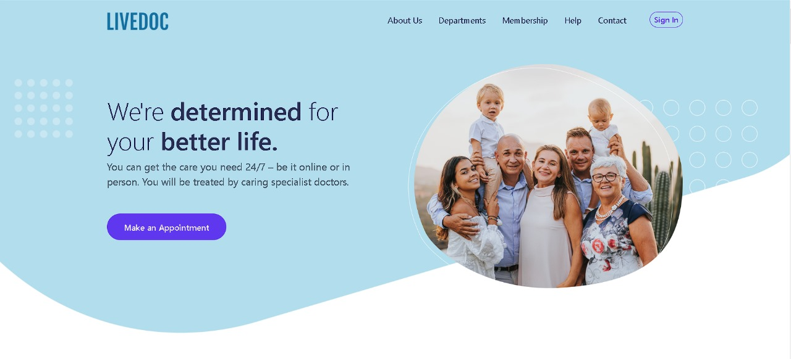
Outcome and result

Slide 15
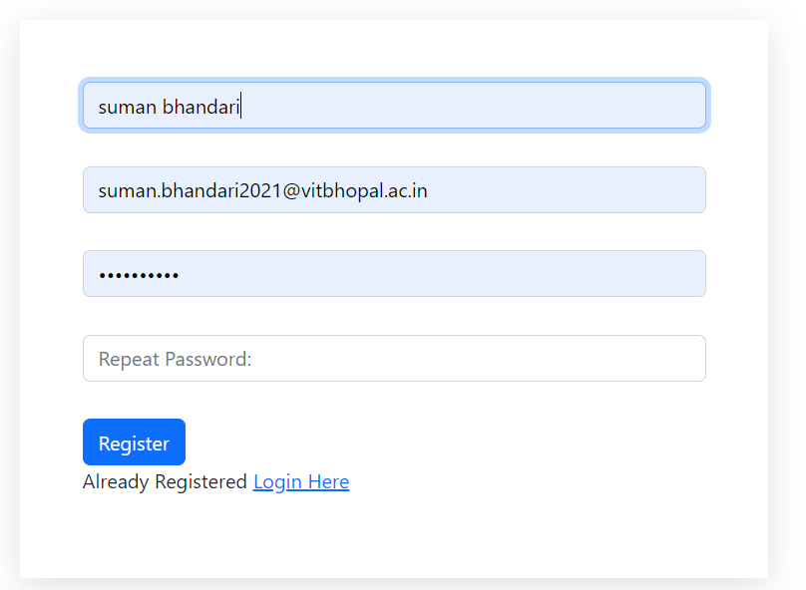
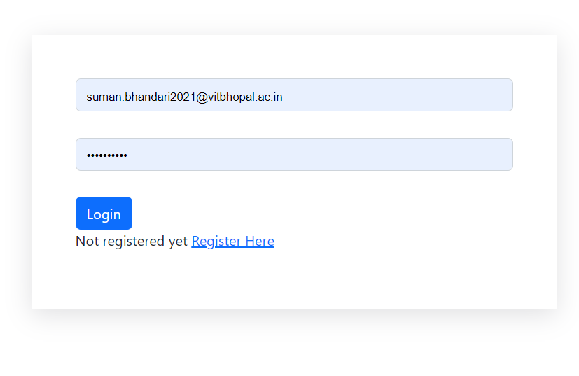
Registration form
Login form

Slide 16
Database

Slide 18
Conclusion
The synthesis of current literature underscores the urgent need for comprehensive healthcare technology solutions that address key challenges in patient care, accessibility, and affordability. By integrating user-friendly platforms with predictive analytics, e-commerce functionalities, cost analysis tools, and medicine recommendation systems, healthcare organizations can enhance patient satisfaction, improve treatment outcomes, and promote equitable access to quality care. Moving forward, leveraging insights from research and embracing technological innovations will be essential in shaping the future of healthcare delivery and advancing patient-centric approaches to wellness.

Slide 19
Reference
List of academic papers, research articles, and resources consulted during the project development.
Proper citations for frameworks, libraries, and technologies used in the implementation.
Smith, J., Johnson, A., & Brown, K. (2019). Patient feedback and satisfaction: Influencing factors in hospital and doctor selection. Journal of Healthcare Management, 25(3), 45-56.
Johnson, R., Kim, S., & Patel, M. (2020). Predictive analytics in healthcare: Applications and implications for patient care. Health Informatics Journal, 17(2), 89-102.
Chen, L., Wang, Y., & Zhang, H. (2018). The impact of e-commerce on medication adherence and patient convenience. Journal of Medical Internet Research, 20(4), e120.
Jones, M., White, E., & Garcia, L. (2021). Cost transparency in healthcare: Improving patient decision-making through budget-based analysis. Healthcare Finance, 37(1), 67-78.
Kim, D., Lee, H., & Park, S. (2019). AI-driven medicine recommendation systems: Enhancing treatment outcomes through personalized suggestions. Journal of Artificial Intelligence in Healthcare, 5(1), 23-36.

Slide 20

Thank you

